Slide 1

CASE STUDY Games Sales

Slide 2
Project Timeline
STAGE 01
PROBLEM QUESTION
TOOLS
STAGE 03
DATA EXTRACTION AND CLEANING USING GOOGLE COLLABS
STAGE 02
STAGE 04
STAGE 05
DATA VISUALIZATION
CONCLUSION

Slide 3
STAGE 01 : Question
1
Which Game is the Oldest and the Newest Games in that Dataset?
Which Publisher Published most of the games?
3
Which Developer Develop most of the games?
2
4
5
Which Series is the most Sales?
Which Series Have the most Games?

Slide 4


STAGE 02: TOOLS

Slide 5
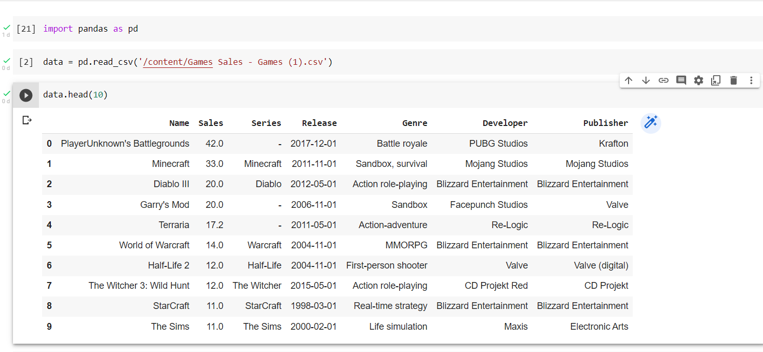
STAGE 03: Data extraction & Data cleaning

Slide 6
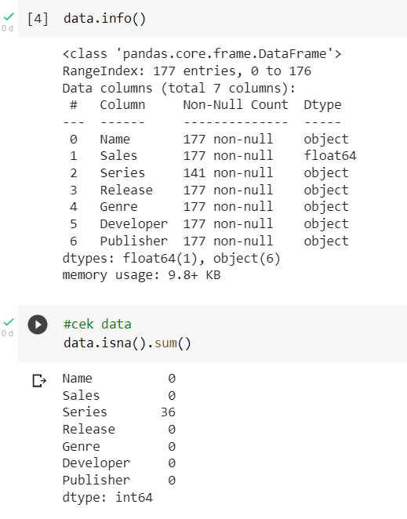
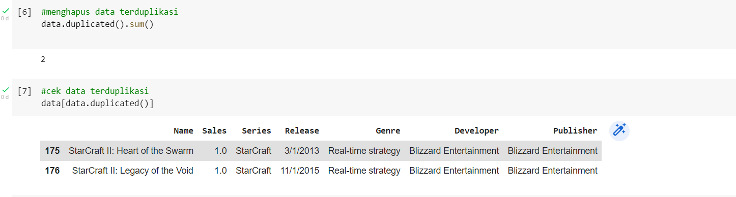
Change the ‘Release’ Column data type to datetime
There are 2 Duplicates data
In ‘Series’ row, there are 36 null rows

Slide 7
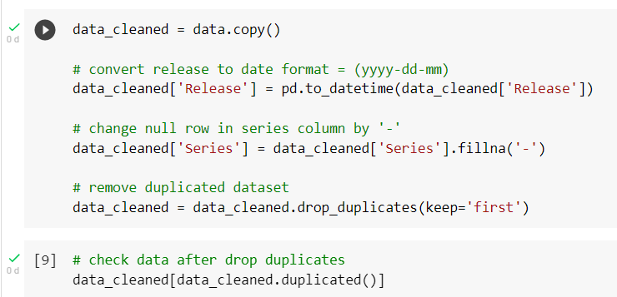
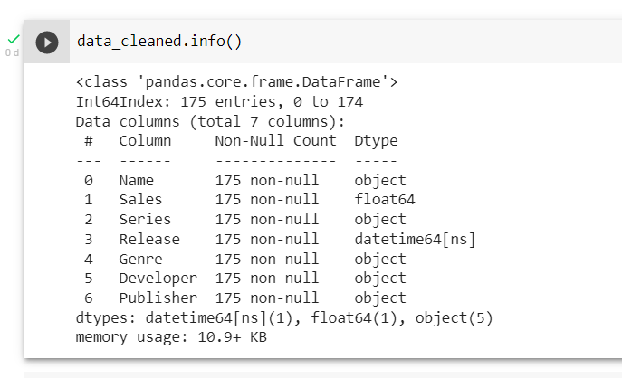
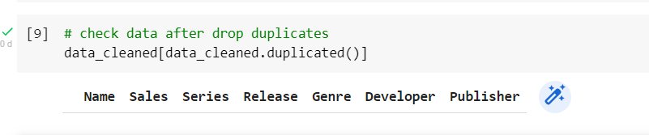
after CLEANSING

Slide 8
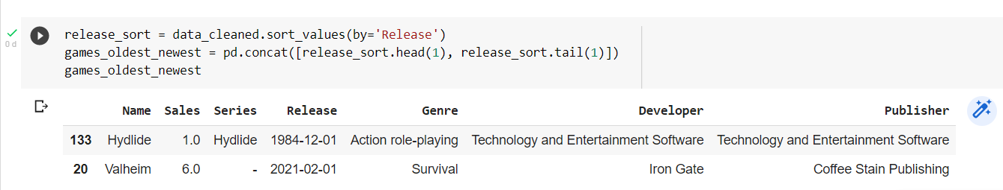
STAGE 04: Data Visualization
Oldest Game = Hydlide (December 1, 1984 Release Date)
Newest Game = Valheim (Februrary 1, 2021 Release Date)

Slide 9
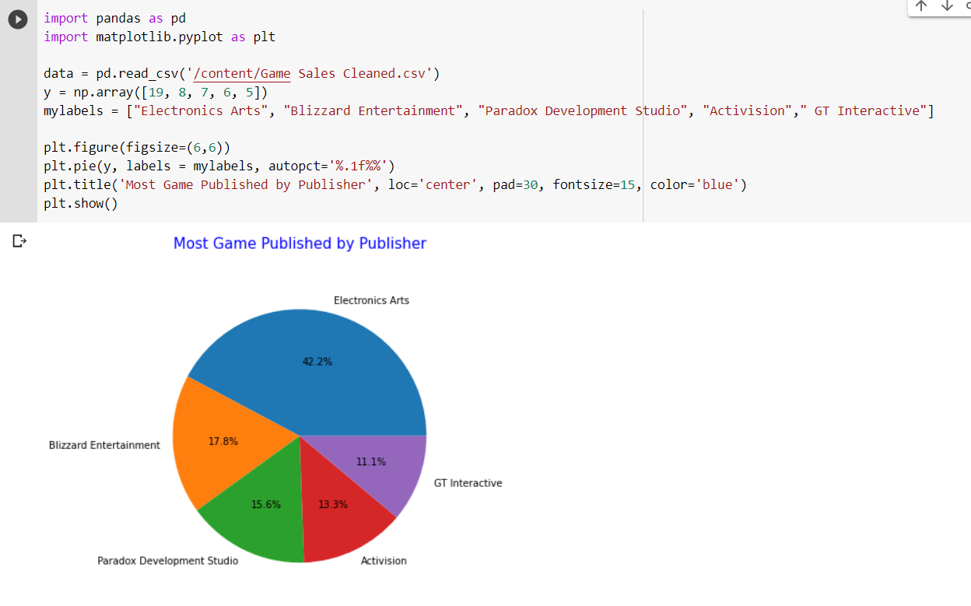
most GAME PUBLISHED BY PUBLISHER
Electronics Arts publisher is the most game published with a total of 19 games (42,2%)

Slide 10
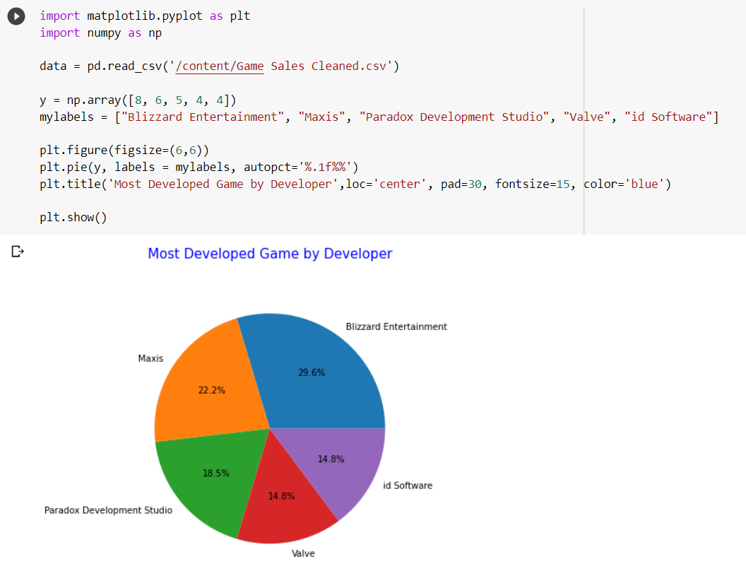
Most game develop by developer
Blizzard Entertainment Developer is the most developed games with a total of 8 games(29,6%)

Slide 11
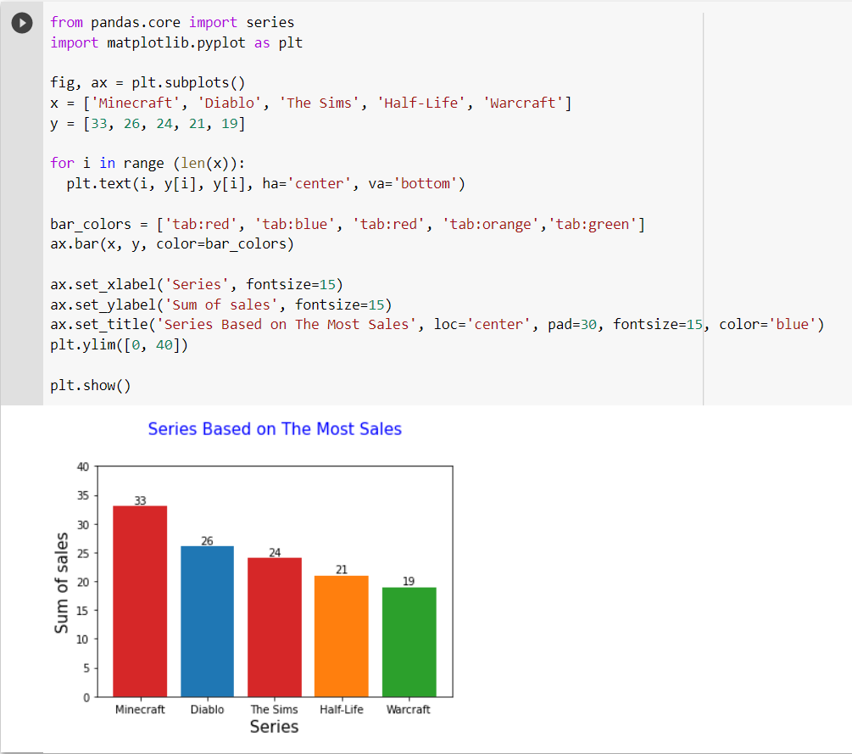
SERIES BASED ON THE MOST SALES
Minecraft is the Series with the most number of sales with a total of 33

Slide 12
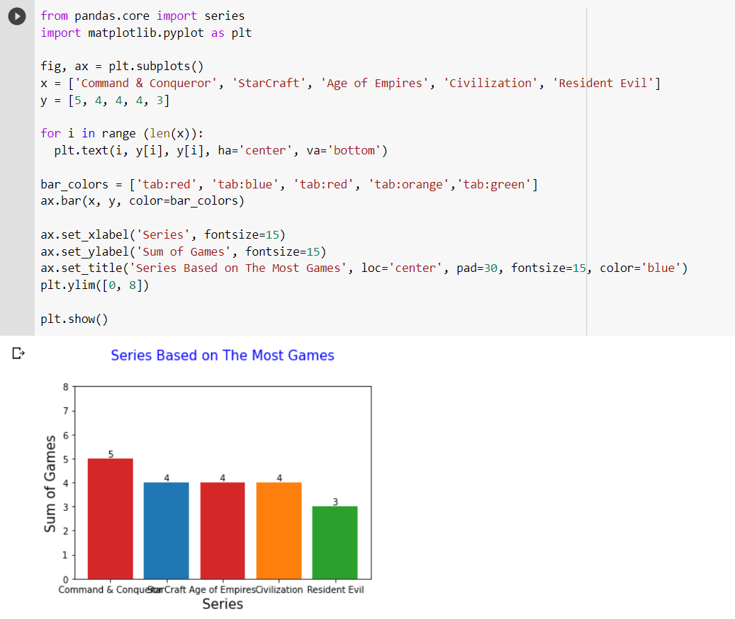
Series based on the most game
Comand and Conqueror Series is the series with the most game with a total of 5 games

Slide 13
STAGE 05: conclusion
Oldest & Newest
Games
- Oldest Game = Hydlide (December 1, 1984 Release Date)
Electronics Arts publisher is the most game published with a total of 19 games (42,2%)
Most Game Develop by Developer
Blizzard Entertainment Developer is the most developed games with a total of 8 games(29,6%)
Most Game Published by Publisher
Series Based on the Most Sales
Series Based on the Most Games
Minecraft is the Series with the most number of sales with a total of 33
Comand and Conqueror Series is the series with the most game with a total of 5 games
- Newest Game = Valheim (Februrary 1, 2021 Release Date)

